Slide 1
Bank of Revature
Camden Snyder
Nisarg Patel
Jeremy Davis
Jason Campbell
Markus Metli
Anthony Renwick

Slide 2
Modules
The Bank of Revature is a full-stack single-page banking application where customers can manage their accounts, employees can create new accounts and make deposits into customer accounts.
Authentication
Registration
Open new bank account
Update user details
Dashboard
Reset Password
Transactions

Slide 3
Technologies
Technologies & Frameworks
Spring Boot
PostgreSQL
Angular
JAVA Mailing Library
Agile
Tools
Postman
Visual Studio Code
STS
pgAdmin4

Slide 4
ER Diagram
FIRST
NAME
LAST
NAME
PHONE NO
DATE OF
BIRTH
ROLE
NAME
PASSWORD
STATE
EMAIL
USER
ADDRESS
CITY
USER ID
BALANCE
HAS
USER_ID
TYPE
ACCOUNT
TYPE
ACCOUNT
ID
OPENING
DATE
BRANCH
ID
TRANSACTION
ACCOUNT
ID
AMOUNT
DATE
TRANSACTION
ID

Slide 5
USE CASE Diagram
Sign up
Create Bank account
View Account
Enter email address for send mail
New user
View transactions
IF user exists
Reset Password
Provide email address and password
Login
EMPLOYEE
CUSTOMER
Log out
Update profile
Create Transactions
SYSTEM

Slide 6
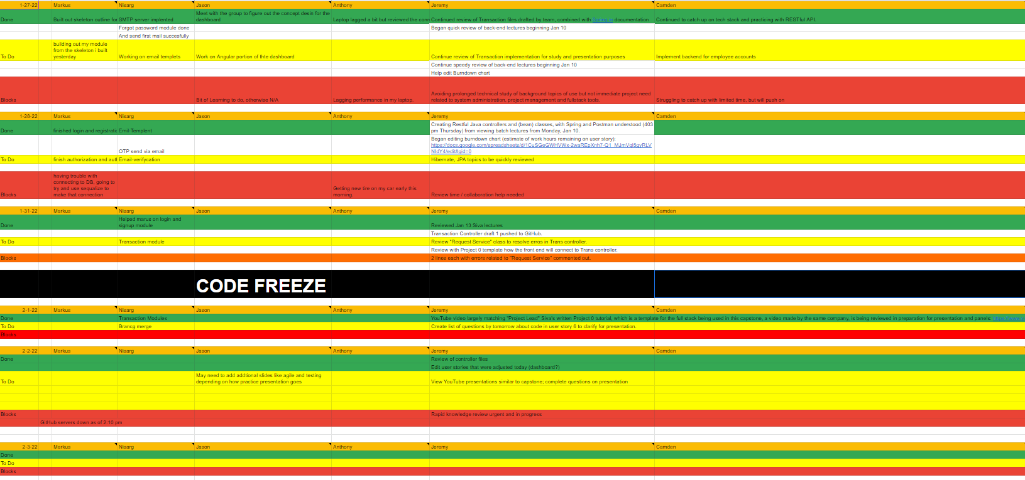
Weekly Sprint

Slide 7
Demonstration
Assumption
Field validation(i.e.Password length and pattern)
Customer account verification using email
Sending email while creating bank account and customer profile account
Two separate portal for admin and customer

Slide 8
Future Goals and milestones
Remote logout
Online transfer service
Chatbot
Nearest services on website map (branches/ATM/etc)
Loan approval system
Enhance security of system

